Slide 2
Stream Classes
A stream is a general name given to a flow of data. In C++ a stream is represented by an object of a particular class. So far we’ve used the cin and cout stream objects. Different streams are used to represent different kinds of data flow. For example, the ifstream class represents data flow from input disk files.
Advantages of Streams
C programmers may wonder what advantages there are to using the stream classes for I/O, instead of traditional C functions such as printf() and scanf(), and—for files—fprintf(), fscanf(), and so on.
One reason is simplicity. If you’ve ever used a %d formatting character when you should have used a %f in printf(), you’ll appreciate this. There are no such formatting characters in streams, since each object already knows how to display itself. This removes a major source of errors.
Another reason is that you can overload existing operators and functions, such as the insertion (<<) and extraction (>>) operators, to work with classes that you create. This makes your own classes work in the same way as the built-in types, which again makes programming easier and more error free (not to mention more aesthetically satisfying).
You may wonder if stream I/O is important if you plan to program in an environment with a Graphics User Interface such as Windows, where direct text output to the screen is not used. Do you still need to know about C++ streams? Yes, because they are the best way to write data to files, and also to format data in memory for later use in text input/output windows and other GUI elements.

Slide 3
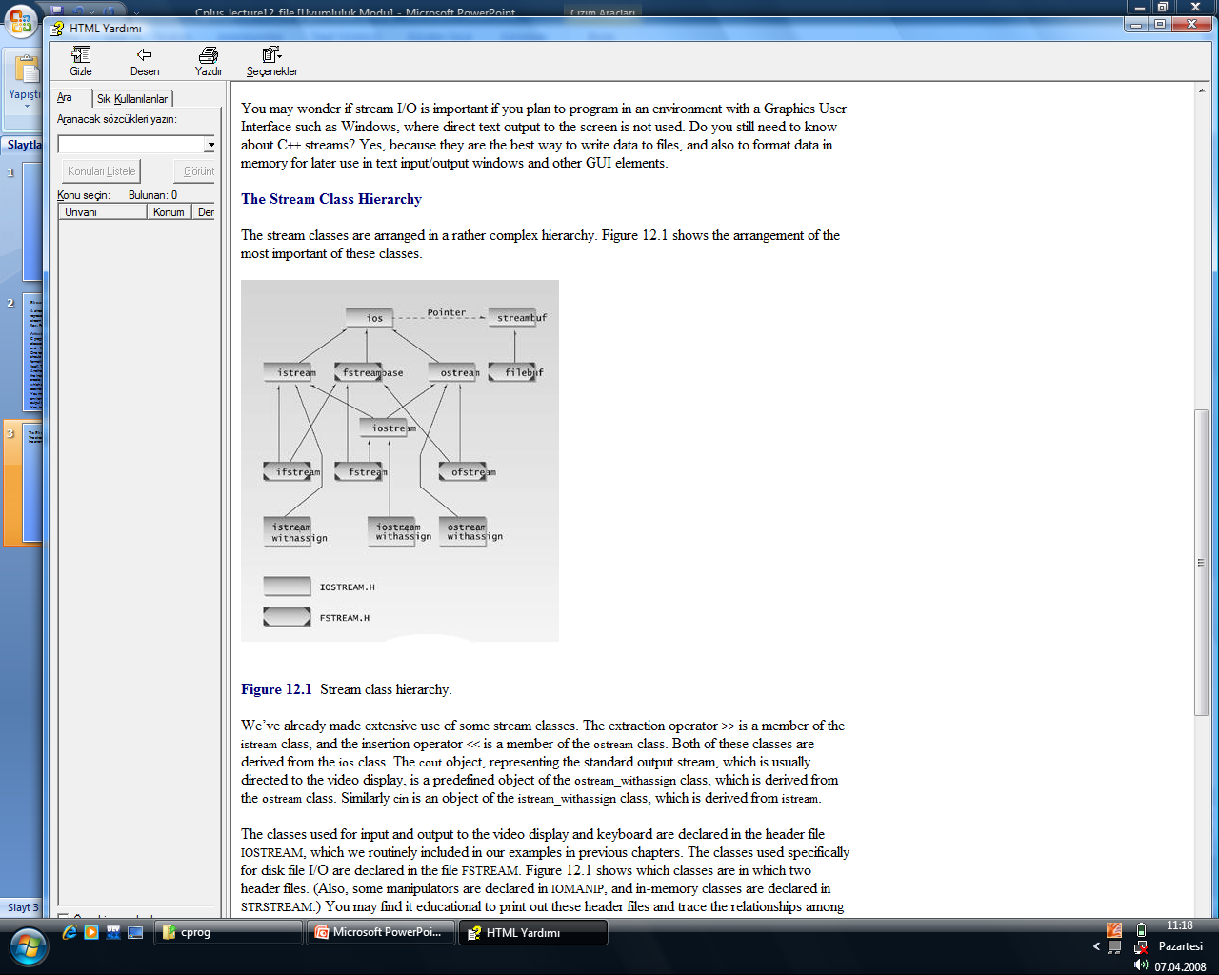
The Stream Class Hierarchy
The stream classes are arranged in a rather complex hierarchy. Figure 12.1 shows the arrangement of the most important of these classes.

Slide 4
The ios Class
The ios class is the granddaddy of all the stream classes, and contains the majority of the features you need to operate C++ streams. The three most important features are the formatting flags, the error-status flags, and the file operation mode. We’ll look at formatting flags and error-status flags next. We’ll save the file operations mode for later, when we talk about disk files.
Formatting Flags
Formatting flags are a set of enum definitions in ios. They act as on/off switches that specify choices for various aspects of input and output format and operation. We won’t provide a detailed discussion of each flag, since we’ve already seen some of them in use, and others are more or less self-explanatory. Some we’ll discuss later in this chapter. Table 12.1 is a complete list of the formatting flags.

Slide 5
Table 12.1 ios Formatting Flags
Table 12.1 ios Formatting Flags
Flag | Meaning
skipws | Skip (ignore) whitespace on input
left | Left adjust output [12.34 ]
right | Right adjust output [ 12.34]
internal | Use padding between sign or base indicator and number [+ 12.34]
dec | Convert to decimal
oct | Convert to octal
hex | Convert to hexadecimal
boolalpha | Convert bool to “true” or “false” strings
showbase | Use base indicator on output (0 for octal, 0x for hex)
showpoint | Show decimal point on output
uppercase | Use uppercase X, E, and hex output letters (ABCDEF)—the default is lowercase
showpos | Display + before positive integers
scientific | Use exponential format on floating-point output [9.1234E2]
fixed | Use fixed format on floating-point output [912.34]
unitbuf | Flush all streams after insertion
stdio | Flush stdout, stderror after insertion

Slide 6
There are several ways to set the formatting flags, and different ones can be set in different ways. Since they are members of the ios class, you must usually precede them with the name ios and the scope-resolution operator (for example, ios::skipws).
All the flags can be set using the setf() and unsetf() ios member functions.
example:
cout.setf(ios::left); // left justify output text cout >> “This text is left-justified”; cout.unsetf(ios::left); // return to default (right justified)
Manipulators
Manipulators are formatting instructions inserted directly into a stream. We’ve seen examples before, such as the manipulator endl, which sends a newline to the stream and flushes it:
cout << “To each his own.” << endl;

Slide 7
Table 12.2 No-Argument ios Manipulators
Manipulator | Purpose
ws | Turn on whitespace skipping on input
dec | Convert to decimal
oct | Convert to octal
hex | Convert to hexadecimal
endl | Insert newline and flush the output stream
ends | Insert null character to terminate an output string
flush | Flush the output stream
lock | Lock file handle
unlock | Unlock file handle
You insert these manipulators directly into the stream. For example, to output var in hexadecimal format, you can say
cout << hex << var;
Note that manipulators affect only the data that follows them in the stream, not the data that precedes them. Table 12.3 summarizes the important manipulators that take arguments. You need the IOMANIP header file for these functions.

Slide 8
Table 12.3 ios Manipulators with Arguments
Manipulator | Argument | Purpose
setw() | field width (int) | Set field width for output
setfill() | fill character (int) | Set fill character for output (default is a space)
setprecision() | precision (int) | Set precision (number of digits displayed)
setiosflags() | formatting flags (long) | Set specified flags
resetiosflags() | formatting flags (long) | Clear specified flags
Functions
The ios class contains a number of functions that you can use to set the formatting flags and perform other tasks. Table 12.4 shows most of these functions, except those that deal with errors, which we’ll examine separately.

Slide 9
Table 12.4 ios Functions
Function | Purpose
ch = fill(); | Return the fill character (fills unused part of field; default is space)
fill(ch); | Set the fill character
p = precision(); | Get the precision (number of digits displayed for floating-point)
precision(p); | Set the precision
w = width(); | Get the current field width (in characters)
width(w); | Set the current field width
setf(flags); | Set specified formatting flags (for example, ios::left)
unsetf(flags); | Unset specified formatting flags
setf(flags, field); | First clear field, then set flags

Slide 11
Disk File I/O with Streams
Most programs need to save data to disk files and read it back in.
Working with disk files requires another set of classes: ifstream for input, fstream for both input and output, and ofstream for output. Objects of these classes can be associated with disk files, and we can use their member functions to read and write to the files.
Referring back to Figure 12.1, you can see that ifstream is derived from istream, fstream is derived from iostream, and ofstream is derived from ostream. These ancestor classes are in turn derived from ios.
Thus the file-oriented classes derive many of their member functions from more general classes. The file-oriented classes are also derived, by multiple inheritance, from the fstreambase class. This class contains an object of class filebuf, which is a file-oriented buffer; and its associated member functions, derived from the more general streambuf class.
The ifstream, ofstream, and fstream classes are declared in the FSTREAM file.
C programmers will note that the approach to disk I/O used in C++ is quite different from that in C.

Slide 12
Formatted File I/O
In formatted I/O, numbers are stored on disk as a series of characters. Thus 6.02, rather than being stored as a 4-byte type float or an 8-byte type double, is stored as the characters ‘6’, ‘.’, ‘0’, and ‘2’. This can be inefficient for numbers with many digits, but it’s appropriate in many situations and easy to implement. Characters and strings are stored more or less normally.

Slide 13
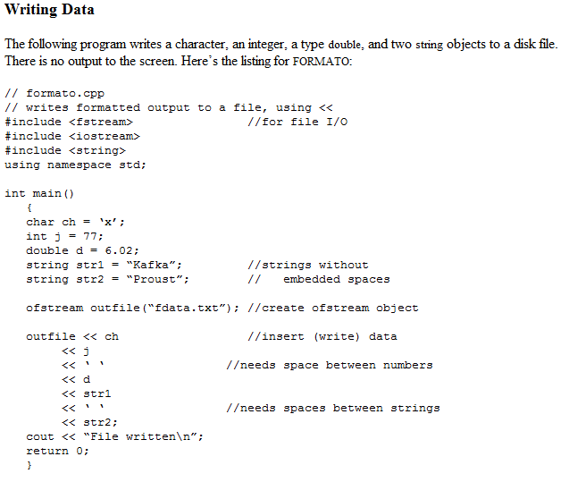

Slide 14
Here we define an object called outfile to be a member of the ofstream class. At the same time, we initialize it to the file FDATA.TXT. This initialization sets aside various resources for the file, and accesses or opens the file of that name on the disk. If the file doesn’t exist, it is created. If it does exist, it is truncated and the new data replaces the old. The outfile object acts much as cout did in previous programs, so we can use the insertion operator (<<) to output variables of any basic type to the file. This works because the insertion operator is appropriately overloaded in ostream, from which ofstream is derived.
When the program terminates, the outfile object goes out of scope. This calls its destructor, which closes the file, so we don’t need to close the file explicitly.
There are several potential formatting glitches. First, you must separate numbers (such as 77 and 6.02) with nonnumeric characters. Since numbers are stored as a sequence of characters, rather than as a fixed-length field, this is the only way the extraction operator will know, when the data is read back from the file, where one number stops and the next one begins. Second, strings must be separated with whitespace for the same reason. This implies that strings cannot contain imbedded blanks. In this example we use the space character (‘ ‘) for both kinds of delimiters. Characters need no delimiters, since they have a fixed length.
You can verify that FORMATO has indeed written the data by examining the FDATA.TXT file with the Windows WORDPAD accessory or the DOS command TYPE.

Slide 15
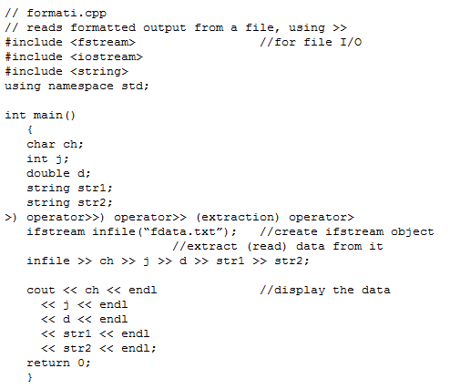
Reading Data
We can read the file generated by FERMATO by using an ifstream object, initialized to the name of the file. The file is automatically opened when the object is created. We can then read from it using the extraction (>>) operator.

Slide 16
Here the ifstream object, which we name infile, acts much the way cin did in previous programs. Provided that we have formatted the data correctly when inserting it into the file, there’s no trouble extracting it, storing it in the appropriate variables, and displaying its contents. The program’s output looks like this:
x
77
6.02
Kafka
Proust
Of course the numbers are converted back to their binary representations for storage in the program. That is, the 77 is stored in the variable j as a type int, not as two characters; and the 6.02 is stored as a double.

Slide 17
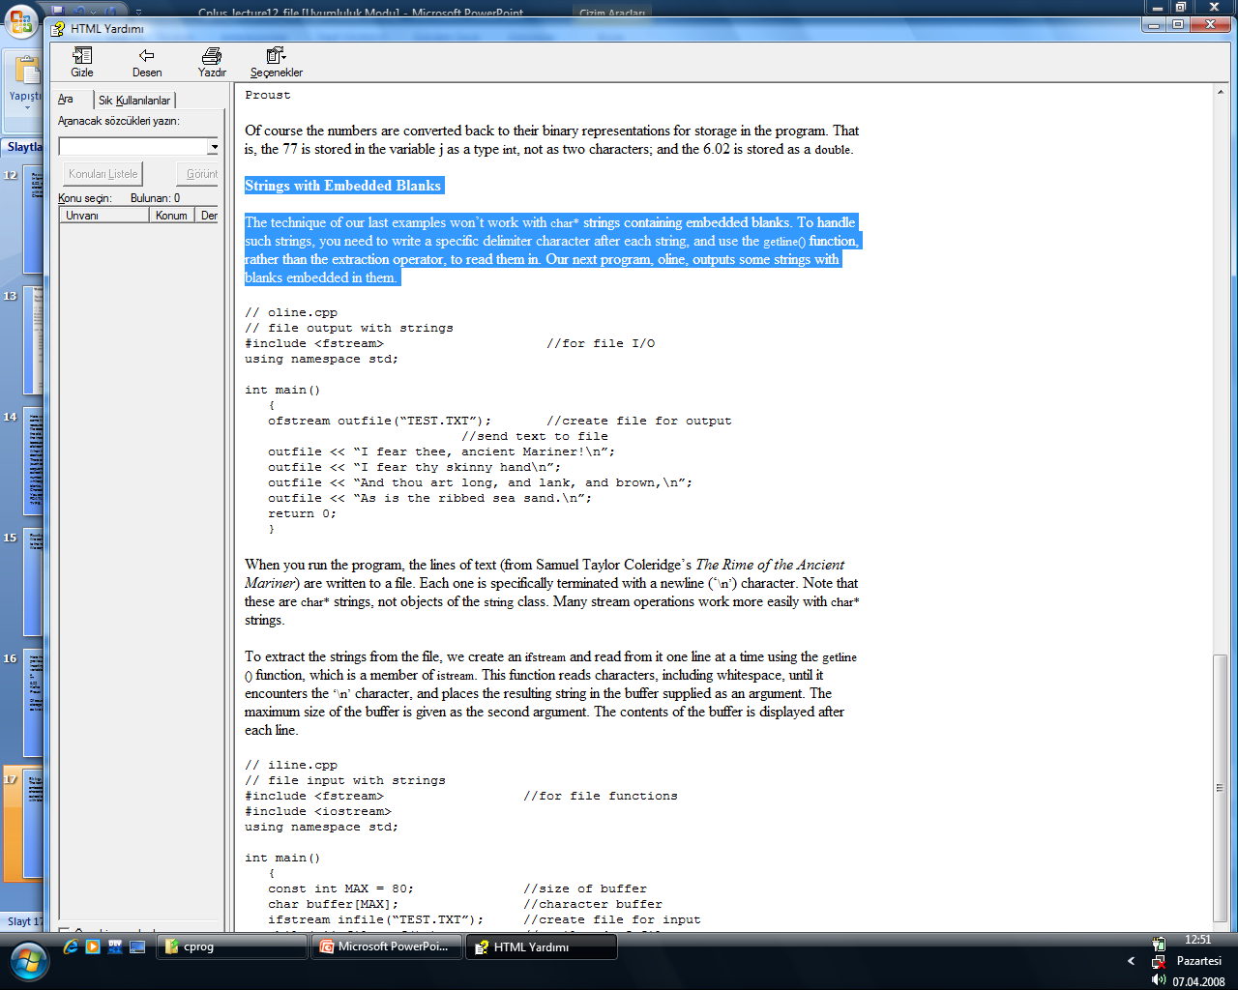
Strings with Embedded Blanks
The technique of our last examples won’t work with char* strings containing embedded blanks. To handle such strings, you need to write a specific delimiter character after each string, and use the getline() function, rather than the extraction operator, to read them in. Our next program, oline, outputs some strings with blanks embedded in them.

Slide 18
When you run the program, the lines of text (from Samuel Taylor Coleridge’s The Rime of the Ancient Mariner) are written to a file. Each one is specifically terminated with a newline (‘\n’) character. Note that these are char* strings, not objects of the string class. Many stream operations work more easily with char* strings.
To extract the strings from the file, we create an ifstream and read from it one line at a time using the getline() function, which is a member of istream. This function reads characters, including whitespace, until it encounters the ‘\n’ character, and places the resulting string in the buffer supplied as an argument. The maximum size of the buffer is given as the second argument. The contents of the buffer is displayed after each line.

Slide 19
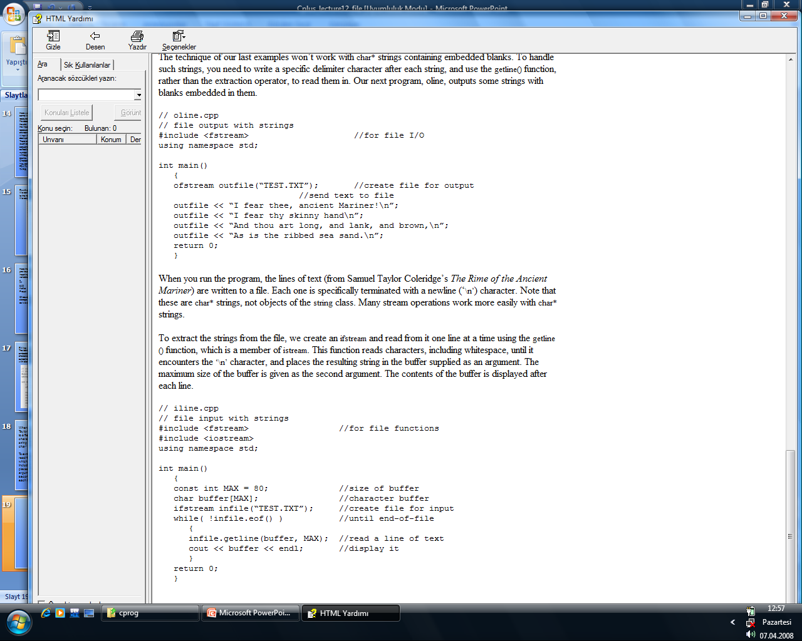

Slide 20
The output of ILINE to the screen is the same as the data written to the TEST.TXT file by OLINE: the four-line Coleridge stanza. The program has no way of knowing in advance how many strings are in the file, so it continues to read one string at a time until it encounters an end-of-file. Incidentally, don’t use this program to read random text files. It requires all the text lines to terminate with the ‘\n’ character, and if you encounter a file in which this is not the case, the program will hang.
Detecting End-of-File
As we have seen, objects derived from ios contain error-status flags that can be checked to determine the results of operations. When we read a file little by little, as we do here, we will eventually encounter an end-of-file (EOF) condition. The EOF is a signal sent to the program from the operating system when there is no more data to read. In ILINE we could have checked for this in the line
while( !infile.eof() ) // until eof encountered
However, checking specifically for an eofbit means that we won’t detect the other error flags, such as the failbit and badbit, which may also occur, although more rarely. To do this, we can change our loop condition:
while( infile.good() ) // until any error encountered
You can also test the stream directly. Any stream object, such as infile, has a value that can be tested for the usual error conditions, including EOF. If any such condition is true, the object returns a zero value. If everything is going well, the object returns a nonzero value. This value is actually a pointer, but the “address” returned has no significance except to be tested for a zero or nonzero value. Thus we can rewrite our while loop again:
while( infile ) // until any error encountered
This is certainly simple, but it may not be quite so clear to the uninitiated what it does.

Slide 21
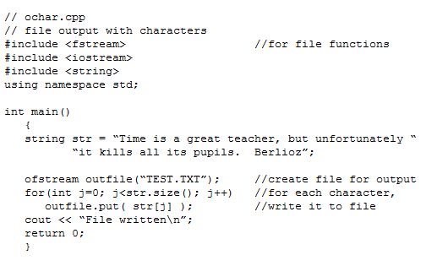
Character I/O
The put() and get() functions, which are members of ostream and istream, respectively, can be used to output and input single characters. Here’s a program, OCHAR, that outputs a string, one character at a time:

Slide 22
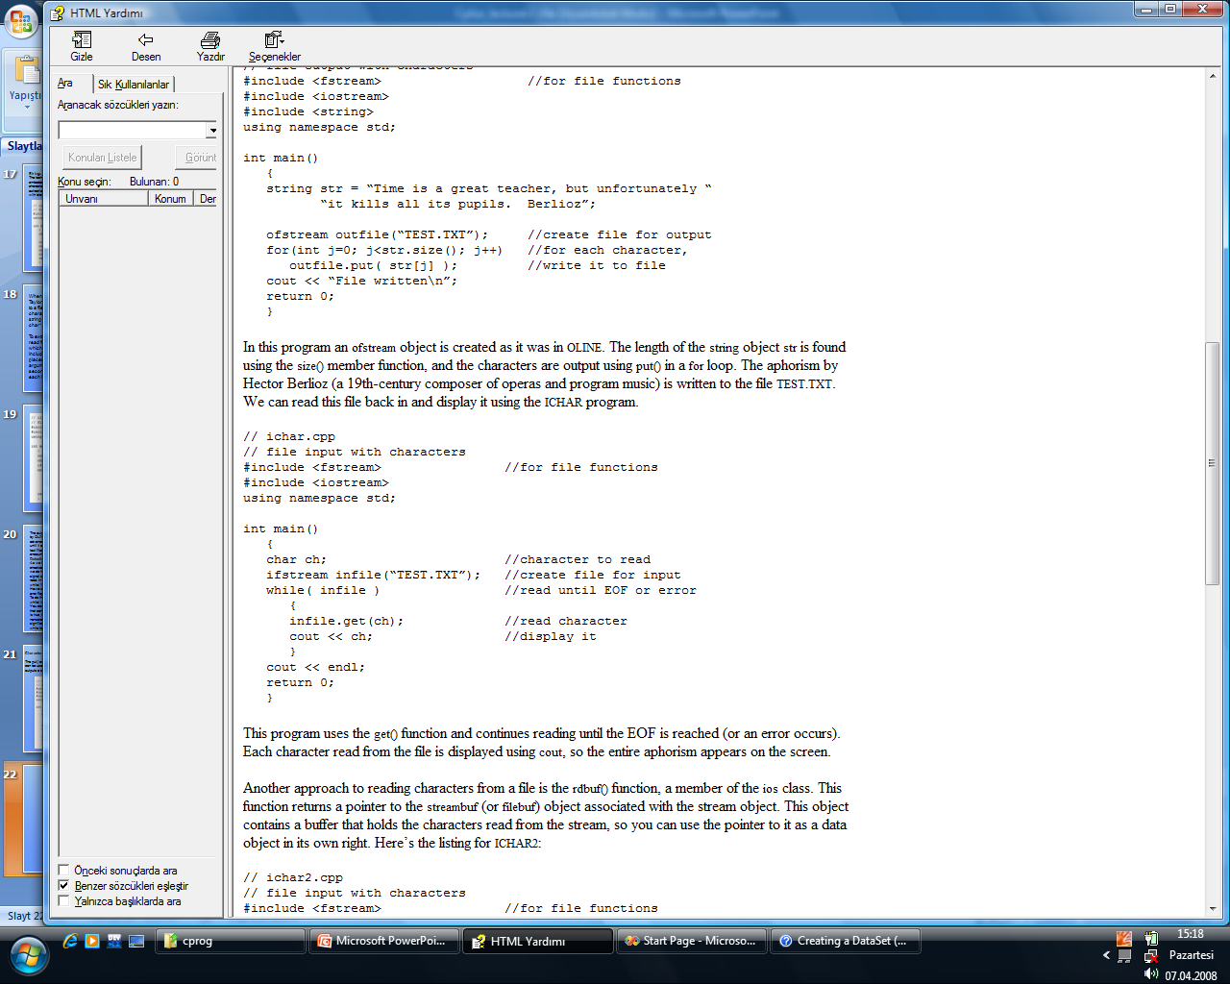

Slide 23
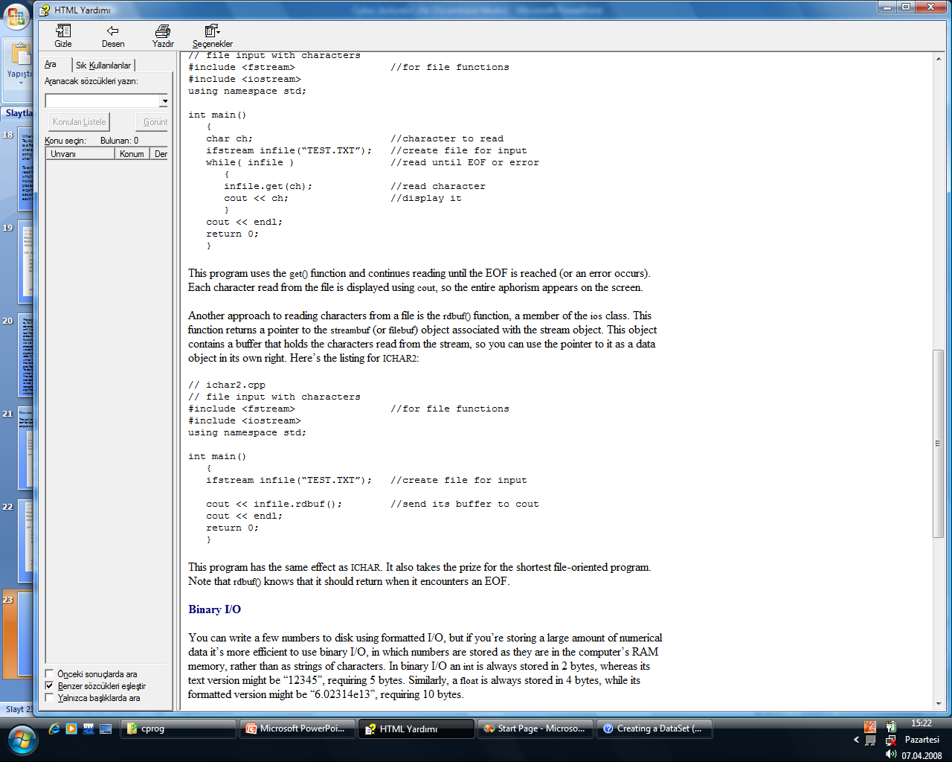

Slide 24
Binary I/O
if you’re storing a large amount of numerical data it’s more efficient to use binary I/O, in which numbers are stored as they are in the computer’s RAM memory, rather than as strings of characters. In binary I/O an int is always stored in 2 bytes, whereas its text version might be “12345”, requiring 5 bytes. Similarly, a float is always stored in 4 bytes, while its formatted version might be “6.02314e13”, requiring 10 bytes.
next example shows how an array of integers is written to disk and then read back into memory, using binary format.
In here, We use two new functions: write(), a member of ofstream; and read(), a member of ifstream.
These functions think about data in terms of bytes (type char). They don’t care how the data is formatted, they simply transfer a buffer full of bytes from and to a disk file. The parameters to write() and read() are the address of the data buffer and its length. The address must be cast, using reinterpret_cast, to type char*, and the length is the length in bytes (characters), not the number of data items in the buffer. Here’s the listing for

Slide 25
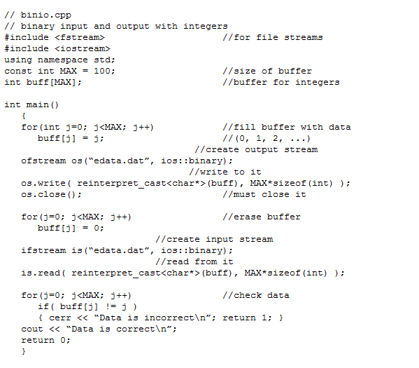

Slide 26
You must use the ios::binary argument in the second parameter to write() and read() when working with binary data. This is because the default, text mode, takes some liberties with the data. For example, in text mode the ‘\n’ character is expanded into two bytes—a carriage-return and a linefeed—before being stored to disk. This makes a formatted text file more readable by DOS-based utilities like TYPE, but it causes confusion when it is applied to binary data, since every byte that happens to have the ASCII value 10 is translated into 2 bytes. The ios::binary argument is an example of a mode bit.
The reinterpret_cast Operator
In the BINIO program (and many others to follow) we use the reinterpret_cast operator to make it possible for a buffer of type int to look to the read() and write() functions like a buffer of type char.
is.read( reinterpret_cast<char*>(buff), MAX*sizeof(int) );
The reinterpret_cast operator is how you tell the compiler, “I know you won’t like this, but I want to do it anyway.” It changes the type of a section of memory without caring if it makes sense, so it’s up to you to use it judiciously.
Closing Files
So far in our example programs there has been no need to close streams explicitly because they are closed automatically when they go out of scope; this invokes their destructors and closes the associated file. However, in BINIO, since both the output stream os and the input stream is are associated with the same file, EDATA.DAT, the first stream must be closed before the second is opened. We use the close() member function for this.

Slide 27
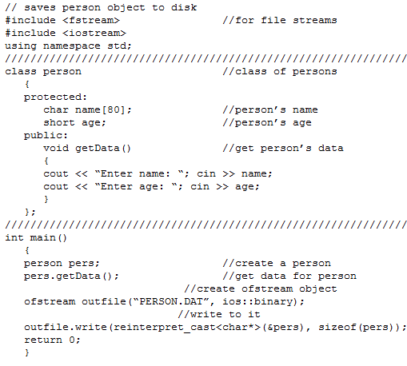
Writing an Object to Disk
When writing an object we generally want to use binary mode. This writes the same bit configuration to disk that was stored in memory, and ensures that numerical data contained in objects is handled properly. Here’s the listing for OPERS, which asks the user for information about an object of class person, and then writes this object to the disk file PERSON.DAT:

Slide 28
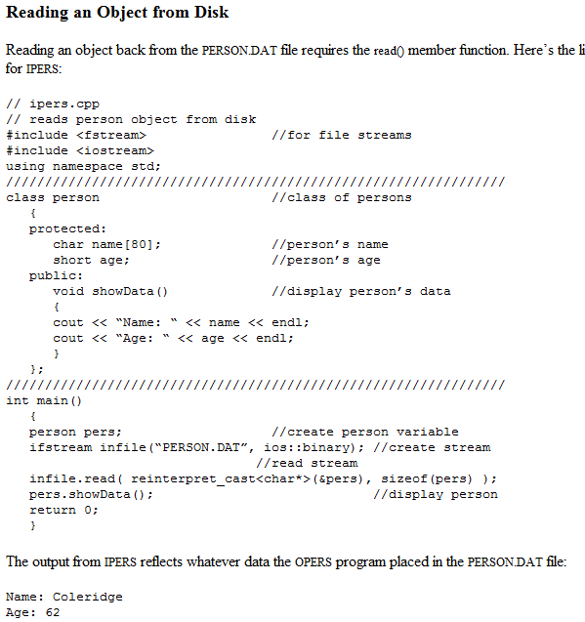

Slide 29
Compatible Data Structures
To work correctly, programs that read and write objects to files, as do OPERS and IPERS, must be talking about the same class of objects. Objects of class person in these programs are exactly 42 bytes long, with the first 40 being occupied with a string representing the person’s name, and the last 2 containing an integer of type short, representing the person’s age. If two programs thought the name field was a different length, for example, neither could accurately read a file generated by the other.
Table 12.10 Mode Bits for open() Function
Mode Bit | Result
in | Open for reading (default for ifstream)
out | Open for writing (default for ofstream)
ate | Start reading or writing at end of file (AT End)
app | Start writing at end of file (APPend)
trunc | Truncate file to zero length if it exists (TRUNCate)
nocreate | Error when opening if file does not already exist
noreplace | Error when opening for output if file already exists, unless ate or app is set
binary | Open file in binary (not text) mode

Slide 30
